Slide 1
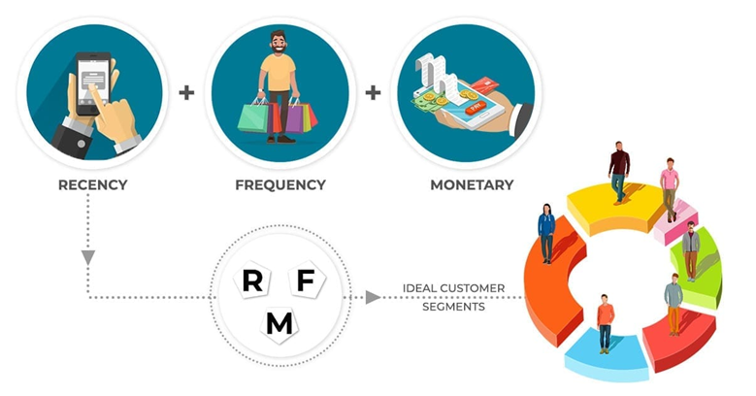
Customer Segmentation using RFM & Customer Life Time Value (CLTV)
.
Notes:
The Objective of this research
To forecast the construction of SFHs in United States, so that it guide construction business community about where to invest ahead of time. Past data can be used analyze complex patterns in SFHs construction across united states (US)
Once we get the prediction, now it is important to know the optimal locations where construction company build plants

Slide 2
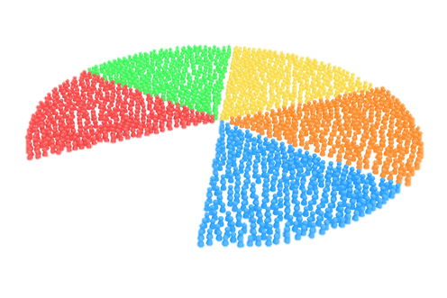

A well-known customer success law, the Pareto principle says that repeat customers generate revenue that is nearly 16 times more efficient than one-time customers. The potency of 80/20 is that 20 percent of a group is responsible for 80 percent of the sales.
Customers’ 80/20 Rule
.
Notes:
The Objective of this research
To forecast the construction of SFHs in United States, so that it guide construction business community about where to invest ahead of time. Past data can be used analyze complex patterns in SFHs construction across united states (US)
Once we get the prediction, now it is important to know the optimal locations where construction company build plants

Slide 3

Agenda
Problem Definition (Use Case)
Why we need Customer Segmentation?
RFM Analysis
Use of Unsupervised Machine Learning (k-Means Clustering)
Customer Life Time Value (CLTV)
How Marketing Team can use Customer Segmentation?
Conclusion
Notes:
The Objective of this research
To forecast the construction of SFHs in United States, so that it guide construction business community about where to invest ahead of time. Past data can be used analyze complex patterns in SFHs construction across united states (US)
Once we get the prediction, now it is important to know the optimal locations where construction company build plants

Slide 4
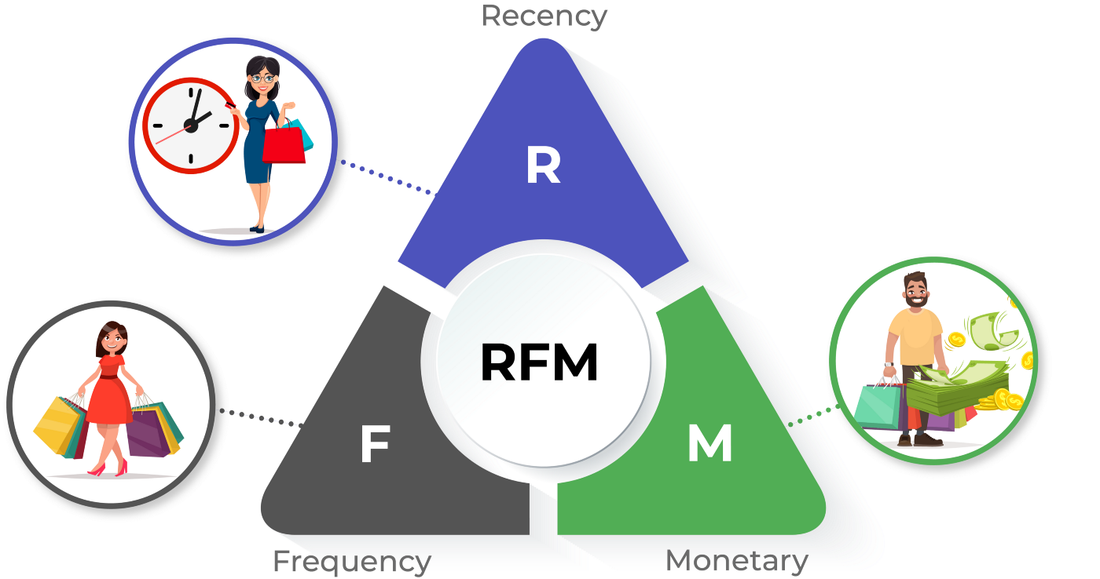

It is difficult for business especially marketing team to identify best customers among million customers. Achieving high Return on Investment (ROI) using limited resources become challenge, hence they might lose best customers (20% customers who bring 80% revenue).
.
Problem Definition
Customers different then each other (Location wise, Gender Wise, Financial Status Wise, Less Spenders, Frequent Visitors, Loyal Customer, Discount Lovers, Never Reply to Email, Demographic Wise, New Customers etc.). We can’t treat every customer the same way with the same content, same channel & same importance.
Notes:
The Objective of this research
To forecast the construction of SFHs in United States, so that it guide construction business community about where to invest ahead of time. Past data can be used analyze complex patterns in SFHs construction across united states (US)
Once we get the prediction, now it is important to know the optimal locations where construction company build plants

Slide 5


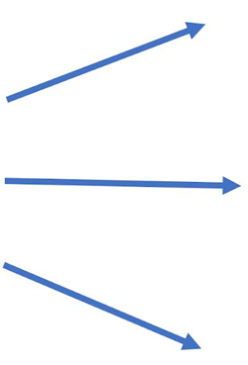


Group your Customers → Customer Segmentation
Customer Segmentation
.
In marketing, market segmentation is the process of dividing a broad consumer or business market, normally consisting of existing and potential customers, into sub-groups of consumers based on some type of shared characteristics
We have groups NOW
Let Say 1 Million Customers
Personalized Marketing
Difficult to Contact All
Easy to Engage
New Product is for old people
Who are Loyal?
Increase ROI
Send Gifts to whom?
Save TIME and RESOURCES
A lot of other marketing campaigns
Better Strategies
Notes:
The Objective of this research
To forecast the construction of SFHs in United States, so that it guide construction business community about where to invest ahead of time. Past data can be used analyze complex patterns in SFHs construction across united states (US)
Once we get the prediction, now it is important to know the optimal locations where construction company build plants

Slide 6
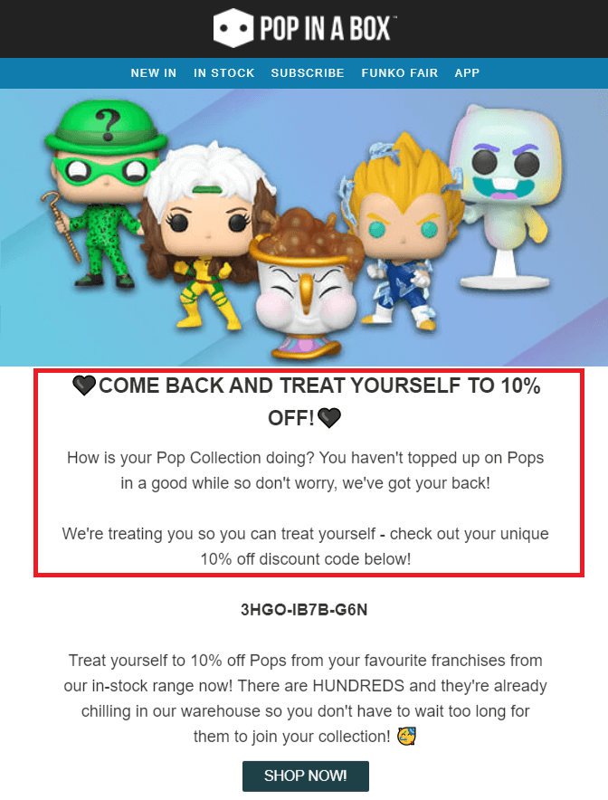



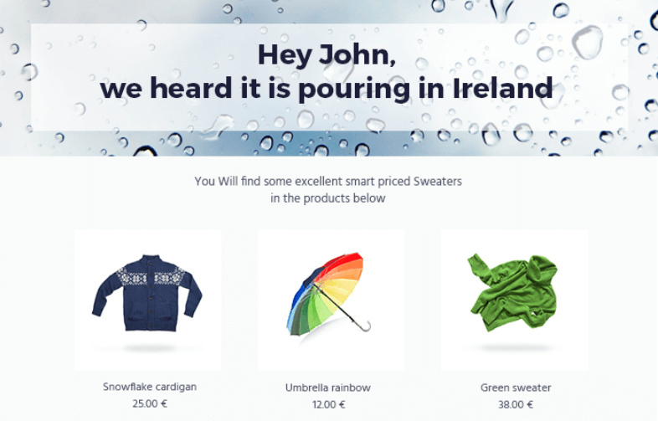

.
Customer Segmentation
Demographic Segmentation (Age, gender, income, education, and marital status etc.)
Geographic Segmentation (Country, state, city, and town)
Psychographic Segmentation (Personality, attitude, values, and interests)
Technographic Segmentation (Mobile-use, desktop use, apps, and software)
Behavioral Segmentation (Tendencies and frequent actions, feature or product use, and habits)
Needs-based (Product or service must-haves and needs of specific customer groups)
Value-based Segmentation (Economic value of specific customer groups for the business)
Examples
Notes:
The Objective of this research
To forecast the construction of SFHs in United States, so that it guide construction business community about where to invest ahead of time. Past data can be used analyze complex patterns in SFHs construction across united states (US)
Once we get the prediction, now it is important to know the optimal locations where construction company build plants

Slide 7
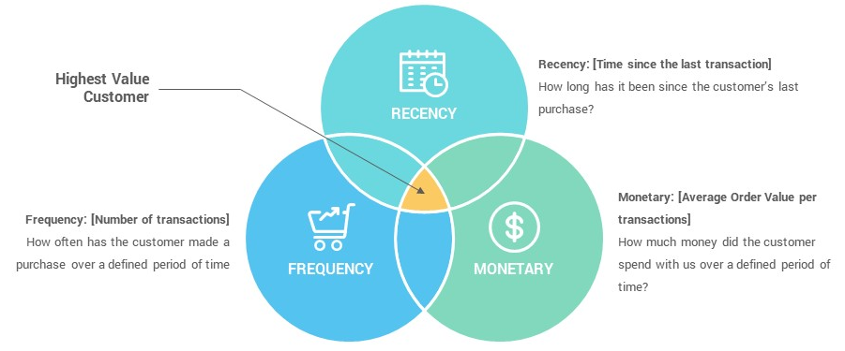
Recency Frequency Monetary (RFM Analysis) Segmentation, is a data driven customer behavior segmentation techniques. The idea is to segment customers based on when their last purchase was (Recency), how often they've purchased in the past (Frequency), and how much they've spent overall (Monetary).
Recency Frequency Monetary (RFM)
.
Theoretically we will have segments like below:
Low Value: Customers who are less active than others, not very frequent buyer/visitor and generates very low - zero - maybe negative revenue. Mid Value: In the middle of everything. Often using our platform (but not as much as our High Values), fairly frequent and generates moderate revenue. High Value: The group we don’t want to lose. High Revenue, Frequency and low Inactivity
Notes:
The Objective of this research
To forecast the construction of SFHs in United States, so that it guide construction business community about where to invest ahead of time. Past data can be used analyze complex patterns in SFHs construction across united states (US)
Once we get the prediction, now it is important to know the optimal locations where construction company build plants

Slide 8
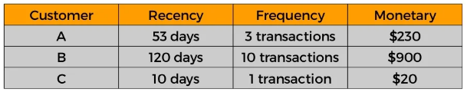
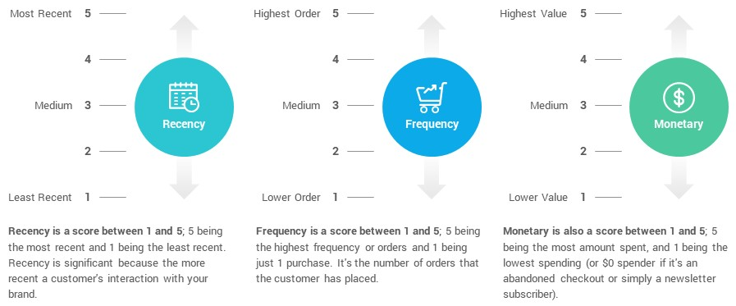
How RFM Works?
.
Customer Segmentation using RFM
Step 1: Calculate RFM Table
Step 2: Using Quartiles/ Other Ranking; Rank the values (lets say from 1 to 5)
Notes:
The Objective of this research
To forecast the construction of SFHs in United States, so that it guide construction business community about where to invest ahead of time. Past data can be used analyze complex patterns in SFHs construction across united states (US)
Once we get the prediction, now it is important to know the optimal locations where construction company build plants

Slide 9
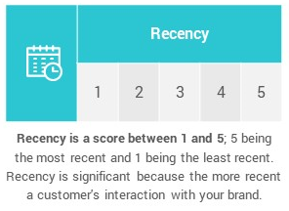
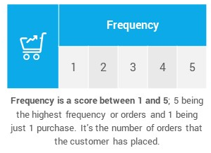
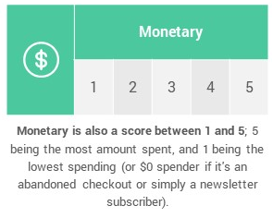
.
Customer Segmentation using RFM
How RFM Works?
Lets Give Score to Customers Data
Notes:
The Objective of this research
To forecast the construction of SFHs in United States, so that it guide construction business community about where to invest ahead of time. Past data can be used analyze complex patterns in SFHs construction across united states (US)
Once we get the prediction, now it is important to know the optimal locations where construction company build plants

Slide 10
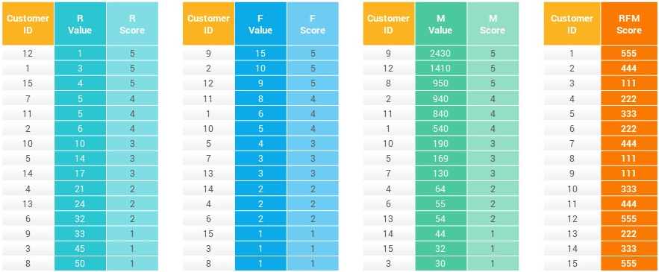

.
Customer Segmentation using RFM
.
Notes:
The Objective of this research
To forecast the construction of SFHs in United States, so that it guide construction business community about where to invest ahead of time. Past data can be used analyze complex patterns in SFHs construction across united states (US)
Once we get the prediction, now it is important to know the optimal locations where construction company build plants

Slide 11
Lets Analyze One Segment
.
Customer Segmentation using RFM
Segment Named “555”, Who they are? How should we deal with these customers?
Recall these Numbers !!!
So these Customers Recently Visited, frequent visitors and bought high price products. They are good for company, we can say that these are CHAMPIONS.
Notes:
The Objective of this research
To forecast the construction of SFHs in United States, so that it guide construction business community about where to invest ahead of time. Past data can be used analyze complex patterns in SFHs construction across united states (US)
Once we get the prediction, now it is important to know the optimal locations where construction company build plants

Slide 12

Lets Analyze One Segment
.
Customer Segmentation using RFM
Segment Named “555”, Who they are? How should we deal with these customers?
Reward Them (Discounts, Gifts etc.)
Ask them for Reviews, other will see those reviews – Help to acquire new customers
Pitch them new products (easy adopters)
Memberships/ Association etc.
Notes:
The Objective of this research
To forecast the construction of SFHs in United States, so that it guide construction business community about where to invest ahead of time. Past data can be used analyze complex patterns in SFHs construction across united states (US)
Once we get the prediction, now it is important to know the optimal locations where construction company build plants

Slide 13
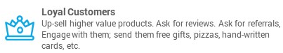
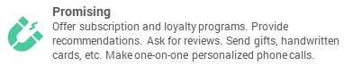


What are other possible Segments?
.
Customer Segmentation using RFM
Notes:
The Objective of this research
To forecast the construction of SFHs in United States, so that it guide construction business community about where to invest ahead of time. Past data can be used analyze complex patterns in SFHs construction across united states (US)
Once we get the prediction, now it is important to know the optimal locations where construction company build plants

Slide 14
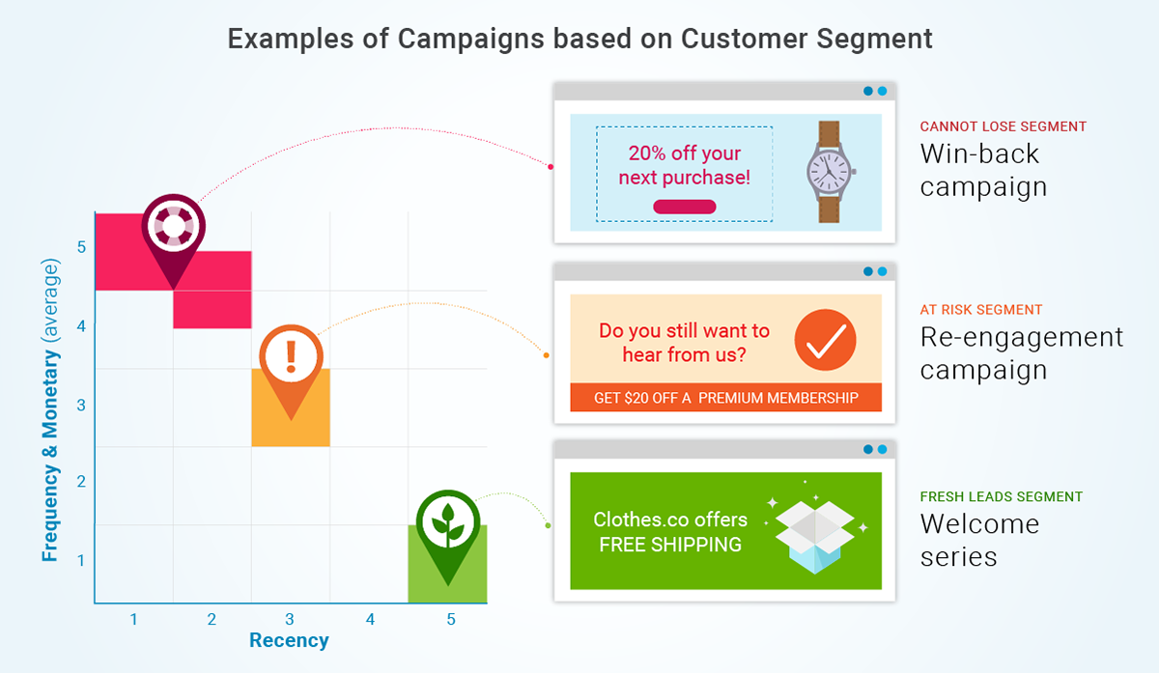
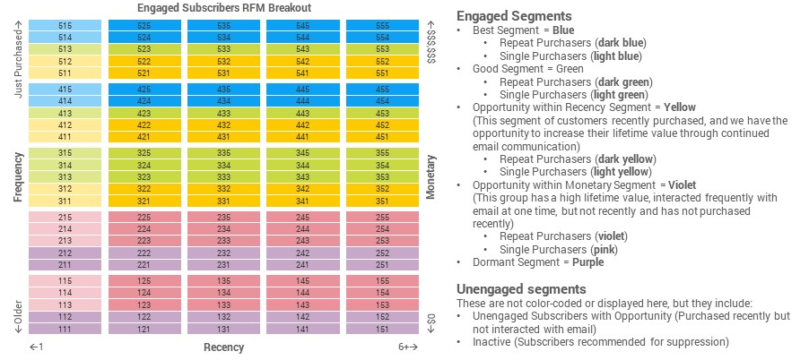
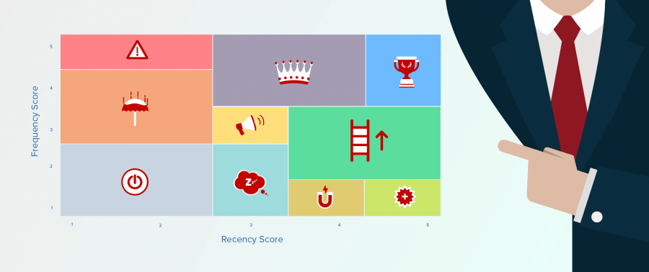


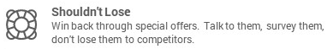
What are other possible Segments?
.
Customer Segmentation using RFM
Notes:
The Objective of this research
To forecast the construction of SFHs in United States, so that it guide construction business community about where to invest ahead of time. Past data can be used analyze complex patterns in SFHs construction across united states (US)
Once we get the prediction, now it is important to know the optimal locations where construction company build plants

Slide 15
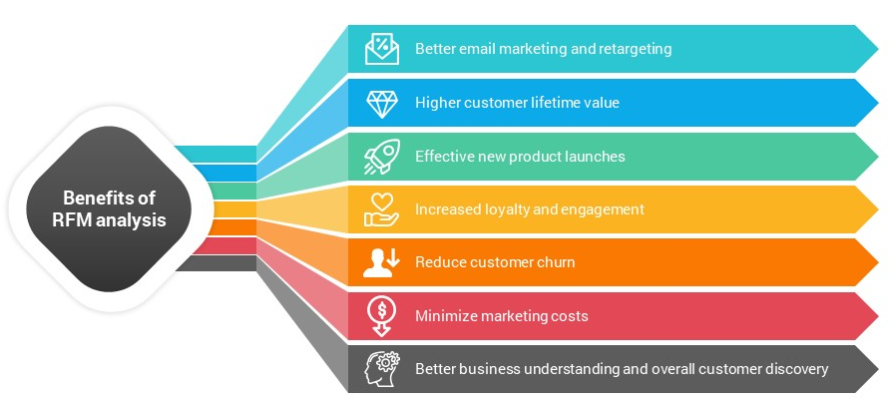
Following are some of the advantages:-
.
Why Segmentation is Useful?
Notes:
The Objective of this research
To forecast the construction of SFHs in United States, so that it guide construction business community about where to invest ahead of time. Past data can be used analyze complex patterns in SFHs construction across united states (US)
Once we get the prediction, now it is important to know the optimal locations where construction company build plants

Slide 16
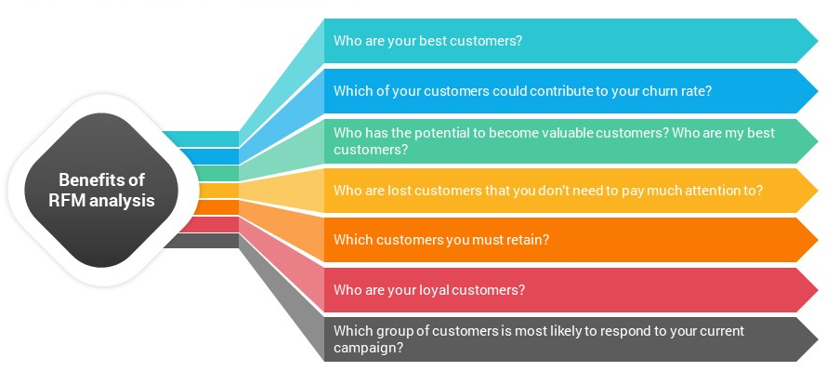
Following are some of the advantages:-
.
Why Segmentation is Useful?
Notes:
The Objective of this research
To forecast the construction of SFHs in United States, so that it guide construction business community about where to invest ahead of time. Past data can be used analyze complex patterns in SFHs construction across united states (US)
Once we get the prediction, now it is important to know the optimal locations where construction company build plants

Slide 17
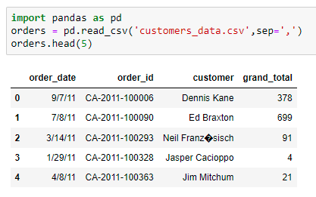
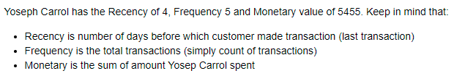
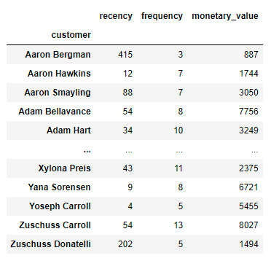
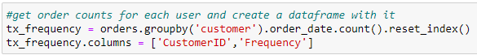
RFM Example – Dummy Data
Customer Segmentation
Notes:
The Objective of this research
To forecast the construction of SFHs in United States, so that it guide construction business community about where to invest ahead of time. Past data can be used analyze complex patterns in SFHs construction across united states (US)
Once we get the prediction, now it is important to know the optimal locations where construction company build plants

Slide 18
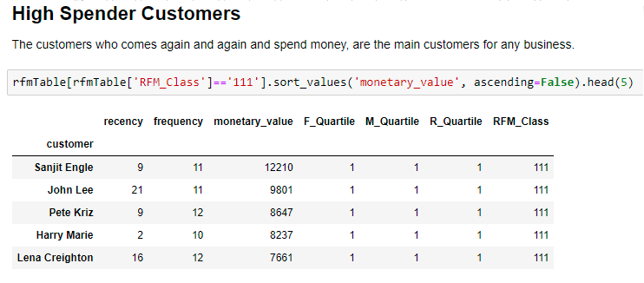
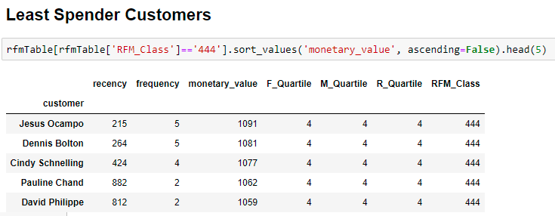
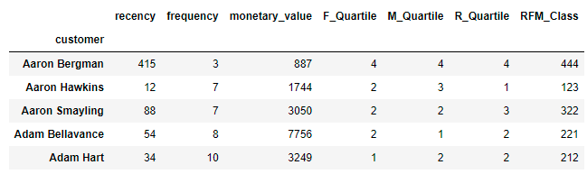
RFM Example – Dummy Data
Customer Segmentation
Notes:
The Objective of this research
To forecast the construction of SFHs in United States, so that it guide construction business community about where to invest ahead of time. Past data can be used analyze complex patterns in SFHs construction across united states (US)
Once we get the prediction, now it is important to know the optimal locations where construction company build plants

Slide 19
Given that RFM seeks to primarily identify valuable customers, it only focuses on the best customers. As a result, it provides limited meaningful scoring on recency, frequency and monetary when most customers don't buy often, spend little and have not purchased lately.
.
Issues with RFM
RFM have fixed number of Segments, but in reality we can have even more clusters and with different RFM ranges instead of fixed – Hence solution is use Machine Learning.
Notes:
The Objective of this research
To forecast the construction of SFHs in United States, so that it guide construction business community about where to invest ahead of time. Past data can be used analyze complex patterns in SFHs construction across united states (US)
Once we get the prediction, now it is important to know the optimal locations where construction company build plants

Slide 20
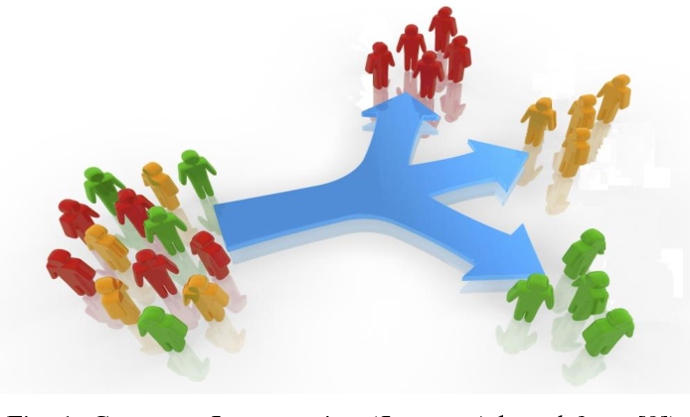
We can use RFM features to do customer segmentation using k-Means Clustering
.
Customer Segmentation using Machine learning (Unsupervised)
First, lets understand how k-Means Clustering is working?
Notes:
The Objective of this research
To forecast the construction of SFHs in United States, so that it guide construction business community about where to invest ahead of time. Past data can be used analyze complex patterns in SFHs construction across united states (US)
Once we get the prediction, now it is important to know the optimal locations where construction company build plants

Slide 21

We can use RFM features to do customer segmentation using k-Means Clustering
.
Customer Segmentation using Machine learning (Unsupervised)
First, lets understand how k-Means Clustering is working?
Use Distance Formula to classify different customers to different segments
How many segments/ clusters should be there? – Use Elbow Method in k-Means
Notes:
The Objective of this research
To forecast the construction of SFHs in United States, so that it guide construction business community about where to invest ahead of time. Past data can be used analyze complex patterns in SFHs construction across united states (US)
Once we get the prediction, now it is important to know the optimal locations where construction company build plants

Slide 22
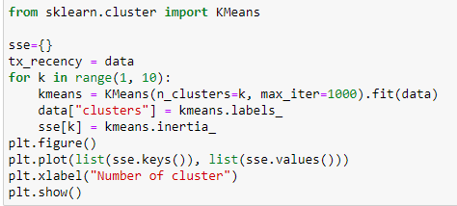
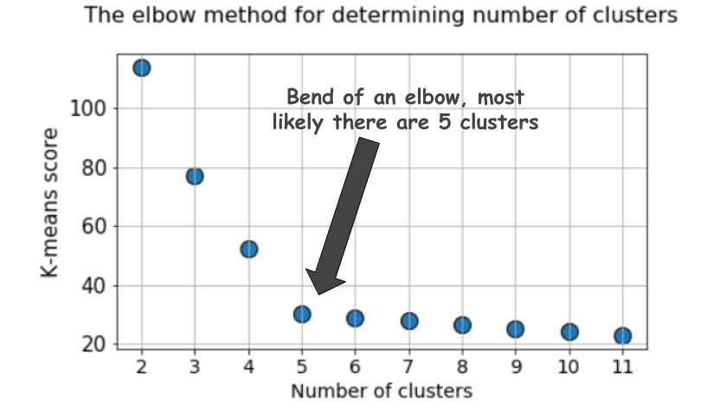
We can use RFM features to do customer segmentation using k-Means Clustering
.
Customer Segmentation using Machine learning (Unsupervised)
First, lets understand how k-Means Clustering is working?
Notes:
The Objective of this research
To forecast the construction of SFHs in United States, so that it guide construction business community about where to invest ahead of time. Past data can be used analyze complex patterns in SFHs construction across united states (US)
Once we get the prediction, now it is important to know the optimal locations where construction company build plants

Slide 23

What are other possible Segments?
.
Customer Segmentation using Machine learning (Unsupervised)
Data will classify into respective segments in multiple iterations of k-Means clustering
Once all the data associated with one of the cluster/ segment – k-Means will stop
Now we will start analyzing each segment/ cluster – to get IDEA of Segment
Notes:
The Objective of this research
To forecast the construction of SFHs in United States, so that it guide construction business community about where to invest ahead of time. Past data can be used analyze complex patterns in SFHs construction across united states (US)
Once we get the prediction, now it is important to know the optimal locations where construction company build plants

Slide 24
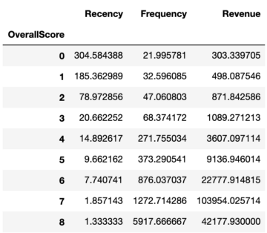
What are other possible Segments?
.
Customer Segmentation using Machine learning (Unsupervised)
There are multiple ways to apply k-Means to RFM features
Apply k-Means clustering at once to complete RFM data or apply k-Means clusters on each feature (Recency, Frequency, Monetary) & then combine or you may use other features along with RFM (age, income, location etc.)
Notes:
The Objective of this research
To forecast the construction of SFHs in United States, so that it guide construction business community about where to invest ahead of time. Past data can be used analyze complex patterns in SFHs construction across united states (US)
Once we get the prediction, now it is important to know the optimal locations where construction company build plants

Slide 25
The scoring clearly shows that customer with score 8 are being the best customer, as they generate most of the revenue of the company (0 being the worst customers)
.
Customer Segmentation using Machine learning (Unsupervised)
To keep things simple, better we name these scores:
0 to 2: Low Value
3 to 4: Mid Value
5+: High Value
Notes:
The Objective of this research
To forecast the construction of SFHs in United States, so that it guide construction business community about where to invest ahead of time. Past data can be used analyze complex patterns in SFHs construction across united states (US)
Once we get the prediction, now it is important to know the optimal locations where construction company build plants

Slide 26
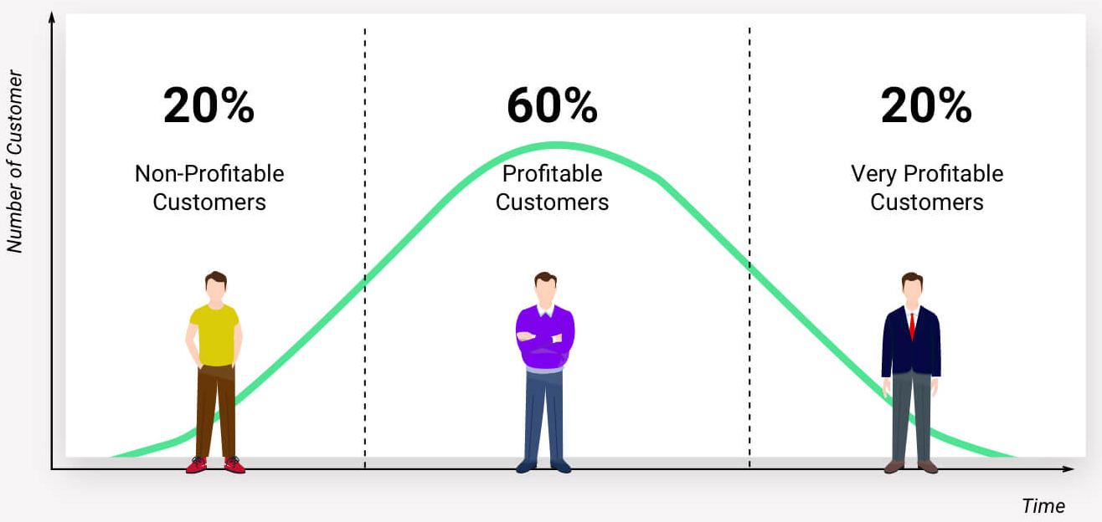
Customer Lifetime Value (CLTV)
.
24
Notes:
The Objective of this research
To forecast the construction of SFHs in United States, so that it guide construction business community about where to invest ahead of time. Past data can be used analyze complex patterns in SFHs construction across united states (US)
Once we get the prediction, now it is important to know the optimal locations where construction company build plants

Slide 27
CLTV Use Case
Customer Life Time Value (LTV)
Not all customers are created equal.
It is type of Value-based segmentation, which differentiates customers by their economic value, grouping customers with the same value level into individual segments that can be distinctly targeted
CLV gives you crucial insight into how much money you should be spending on acquiring your customers by telling you how much value they’ll bring to your business in the long run.
Two approaches for LTV
Historical Approach
Predictive Approach
Notes:
The Objective of this research
To forecast the construction of SFHs in United States, so that it guide construction business community about where to invest ahead of time. Past data can be used analyze complex patterns in SFHs construction across united states (US)
Once we get the prediction, now it is important to know the optimal locations where construction company build plants

Slide 28

We invest in customers (acquisition costs, offline ads, promotions, discounts & etc.) to generate revenue and be profitable. Naturally, these actions make some customers super valuable in terms of lifetime value but there are always some customers who pull down the profitability. We need to identify these behavior patterns, segment customers and act accordingly
Why We Need CLTV?
.
Notes:
The Objective of this research
To forecast the construction of SFHs in United States, so that it guide construction business community about where to invest ahead of time. Past data can be used analyze complex patterns in SFHs construction across united states (US)
Once we get the prediction, now it is important to know the optimal locations where construction company build plants

Slide 29

Customer Life Time Value
Aggregate Model
Aggregate Model
Calculating LTV by using the average revenue per customer based on past transactions
This method gives us a single value for the CLV. This is not detailed approach (give a single value), because it give us aggregated value for each customer.
Not all customers are same in term of monetary value
Cohort Model
Instead of simply assuming all the customers to be one group, we can try to split them into multiple groups and calculate the CLV for each group.
This model overcomes the major drawback of the simple Aggregate model which assumes the entire customers as a single group.
his help us to find successful marketing campaigns, products and other strategies like posting on Facebook, Social Media, Discounts etc.
Notes:
The Objective of this research
To forecast the construction of SFHs in United States, so that it guide construction business community about where to invest ahead of time. Past data can be used analyze complex patterns in SFHs construction across united states (US)
Once we get the prediction, now it is important to know the optimal locations where construction company build plants

Slide 30
Customer Life Time Value
Predictive Approach
Machine Learning Model
Using regression techniques to fit on past data to predict the LTV
We need to make dataset for this
Probabilistic Model
It tries to fit a probability distribution to the data and estimates the future count of transactions and monetary value for each transaction.
LIFETIMES is an open source Python Library I will be using for Calculating LTV
Notes:
The Objective of this research
To forecast the construction of SFHs in United States, so that it guide construction business community about where to invest ahead of time. Past data can be used analyze complex patterns in SFHs construction across united states (US)
Once we get the prediction, now it is important to know the optimal locations where construction company build plants

Slide 31
These customers have proven to have a higher willingness to pay, so don't use discount pricing to generate incremental sales. Instead, focus on value added offers through Product recommendations based on previous purchases and also Consider premium offers, subscription tiers
.
3 Segments LTV Marketing Strategies
HIGH LTV CUSTOMERS
Focus on loyalty programs and new product introductions
Notes:
The Objective of this research
To forecast the construction of SFHs in United States, so that it guide construction business community about where to invest ahead of time. Past data can be used analyze complex patterns in SFHs construction across united states (US)
Once we get the prediction, now it is important to know the optimal locations where construction company build plants

Slide 32
Marketing Strategies: Having clear strategies in place for Low LTV customers, such as triggered reminder emails, phone numbers will pay dividends
.
3 Segments LTV Marketing Strategies
LOW LTV CUSTOMERS
Marketing Strategies: Focus on increasing monetization through company product recommendations based on past purchases
MID LTV CUSTOMERS
Notes:
The Objective of this research
To forecast the construction of SFHs in United States, so that it guide construction business community about where to invest ahead of time. Past data can be used analyze complex patterns in SFHs construction across united states (US)
Once we get the prediction, now it is important to know the optimal locations where construction company build plants

Slide 33
Varying Tenures
When you have varying tenures of customers, then it is better to calculate the LTV, RFM and other use cases discussed here, on multiple time frames. For example let say, LTV values
Calculate LTV values for customers at each month
Evaluate how customer increase sale or decrease sale, you can evaluate many patterns/ behavior of customer from this
You can easily evaluate which customers are churned or about to churn using Exploratory Data Analysis and statistical analysis
You can have better idea about your service/ products – those products can be easily identified which cause customer to churn
You can have better marketing strategy
Notes:
The Objective of this research
To forecast the construction of SFHs in United States, so that it guide construction business community about where to invest ahead of time. Past data can be used analyze complex patterns in SFHs construction across united states (US)
Once we get the prediction, now it is important to know the optimal locations where construction company build plants

Slide 34
Customer Life Time Value
Python Lifetimes
https://lifetimes.readthedocs.io/en/latest/
Lifetimes can be used to analyze your users based on a few assumption:
Users interact with you when they are “alive”.
Users under study may “die” after some period of time.
Applications
Predicting how often a visitor will return to your website. (Alive = visiting. Die = Churned)
Understanding how frequently a patient may return to a hospital. (Alive = visiting. Die = maybe the patient moved to a new city, or became deceased.)
Predicting individuals who have churned using only their usage history. (Alive = logins. Die = removed the app)
Predicting repeat purchases from a customer. (Alive = actively purchasing. Die = became disinterested with your product)
Predicting the lifetime value of your customers
Notes:
The Objective of this research
To forecast the construction of SFHs in United States, so that it guide construction business community about where to invest ahead of time. Past data can be used analyze complex patterns in SFHs construction across united states (US)
Once we get the prediction, now it is important to know the optimal locations where construction company build plants

Slide 35
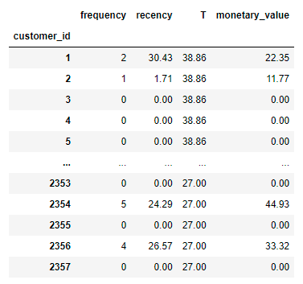
Other Way for LTV Calculation
Customer Life Time Value – (using dummy dataset)
Step 1: I will transform Data into given form
Customer Unique ID – For Calculating LTV
Important Thing about Calculating LTV – We always Select Specific Time Frame like selecting transactions of whole year or a month.
Frequency – Total Orders by Customers
Recency – Today’s Order Date Minus Last Order Date
Monetary – Total Transactions and Revenue by Specific Customer
Notes:
The Objective of this research
To forecast the construction of SFHs in United States, so that it guide construction business community about where to invest ahead of time. Past data can be used analyze complex patterns in SFHs construction across united states (US)
Once we get the prediction, now it is important to know the optimal locations where construction company build plants

Slide 36
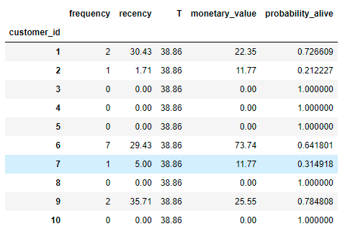
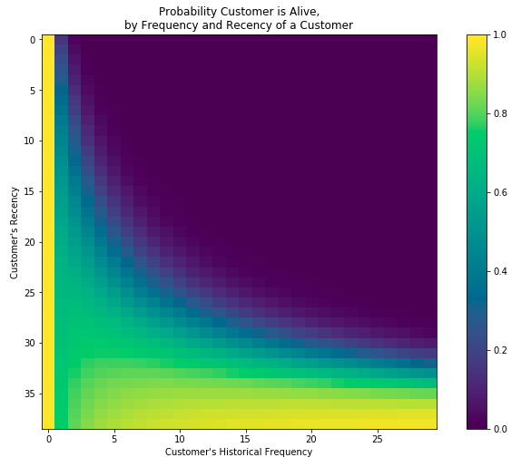
Working with your Data
Customer Life Time Value – (using dummy data)
Step 2: Using Lifetimes Calculate the Probability of Alive (for each Customer)
http://www.brucehardie.com/notes/021/palive_for_BGNBD.pdf
Notes:
The Objective of this research
To forecast the construction of SFHs in United States, so that it guide construction business community about where to invest ahead of time. Past data can be used analyze complex patterns in SFHs construction across united states (US)
Once we get the prediction, now it is important to know the optimal locations where construction company build plants

Slide 37
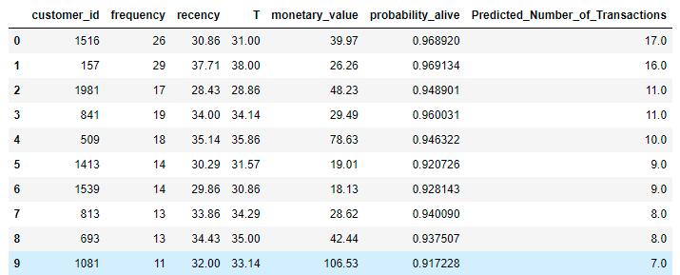
Working with your Data
Customer Life Time Value – (using dummy data)
Step 3: Predict Number of Transactions in next 30 or X days using Conditional Probability (for each Customer)
http://brucehardie.com/papers/018/fader_et_al_mksc_05.pdf
Notes:
The Objective of this research
To forecast the construction of SFHs in United States, so that it guide construction business community about where to invest ahead of time. Past data can be used analyze complex patterns in SFHs construction across united states (US)
Once we get the prediction, now it is important to know the optimal locations where construction company build plants

Slide 38
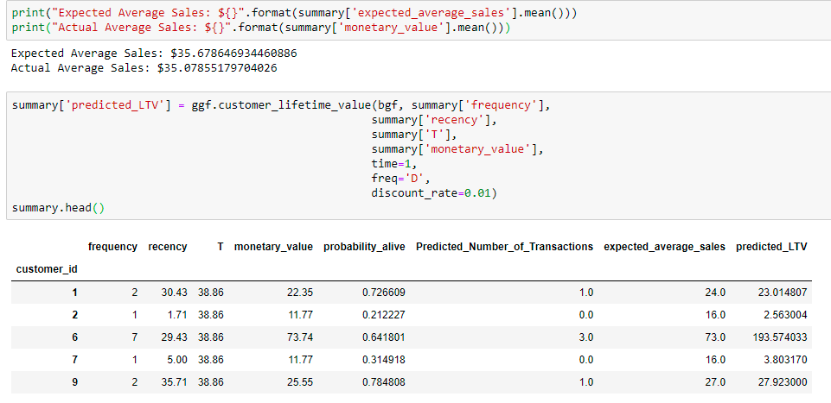
Working with your Data
Customer Life Time Value – (I will use company data)
Step 4: Calculate LTV for each Customer using Gamma Gamma Fitter (Statistical Method)
Notes:
The Objective of this research
To forecast the construction of SFHs in United States, so that it guide construction business community about where to invest ahead of time. Past data can be used analyze complex patterns in SFHs construction across united states (US)
Once we get the prediction, now it is important to know the optimal locations where construction company build plants

Slide 39
How LTV Impact Marketing?
You will always have to spend money to acquire new customers and retain old ones. In fact, acquiring new customers costs almost five times more than retaining existing ones. Moreover, while the probability of selling to an existing customer is 60-70%, the chance of selling to a new customer is just 5-20%.
By clearly estimating LTV, marketing teams can focus more on targeting qualified leads who can be easily acquired with the lowest costs. For instance, spending $10 acquiring a lead that ends up buying more than $500 of products may seem like a great bargain. But what if your close ratio was 5%? You would have to spend $10 x 20 leads = $200 just for acquiring one customer who would buy your product worth $500.
A clear LTV helps set the maximum marketing budget for both acquiring new customers, and for maintaining relationships with existing ones.
It is also important for marketing teams to understand that, just like there isn’t a simple target segment, there also isn’t just a single LTV number. Instead, they need to segment their marketing efforts according to the value of the target customer segment.
Notes:
The Objective of this research
To forecast the construction of SFHs in United States, so that it guide construction business community about where to invest ahead of time. Past data can be used analyze complex patterns in SFHs construction across united states (US)
Once we get the prediction, now it is important to know the optimal locations where construction company build plants

Slide 40
How to Increase LTV?
Optimize Onboarding - It’s important to make the first impression positive. Customers often need education on the features and benefits of your product to truly understand how the product can positively impact their live – Do effective onboarding
Listen to your Customers – Customer appreciate when their voices are heard – Get weekly/ monthly feedback from users, online survey, ask them what else you need, launch custom products
Loyalty Program - Implementing a loyalty program can be a great way to personalize the customer experience while incentivizing repeat purchases. Some common loyalty programs offer reward points, or the ability to unlock free and discounted product after the accumulation of purchases. For example, buy nine Smoothees and get the tenth free
Retargeting - One of the most important tactics to improve customer lifetime value is to re-engage customers who have had a previous experience with the brand. Retargeting can be a simple reminder of the company and at the very least, increase brand recognition.
Notes:
The Objective of this research
To forecast the construction of SFHs in United States, so that it guide construction business community about where to invest ahead of time. Past data can be used analyze complex patterns in SFHs construction across united states (US)
Once we get the prediction, now it is important to know the optimal locations where construction company build plants

Slide 41

Conclusion
i
Notes:
The Objective of this research
To forecast the construction of SFHs in United States, so that it guide construction business community about where to invest ahead of time. Past data can be used analyze complex patterns in SFHs construction across united states (US)
Once we get the prediction, now it is important to know the optimal locations where construction company build plants

